Slide 1
Homework 10 (grouping) (Discussion)
2~3 persons per group
Finds some Argo buoys that passed through Kuroshio and located in the South China Sea.
Compare the water properties of Kuroshio and in the South China Sea.

Slide 2
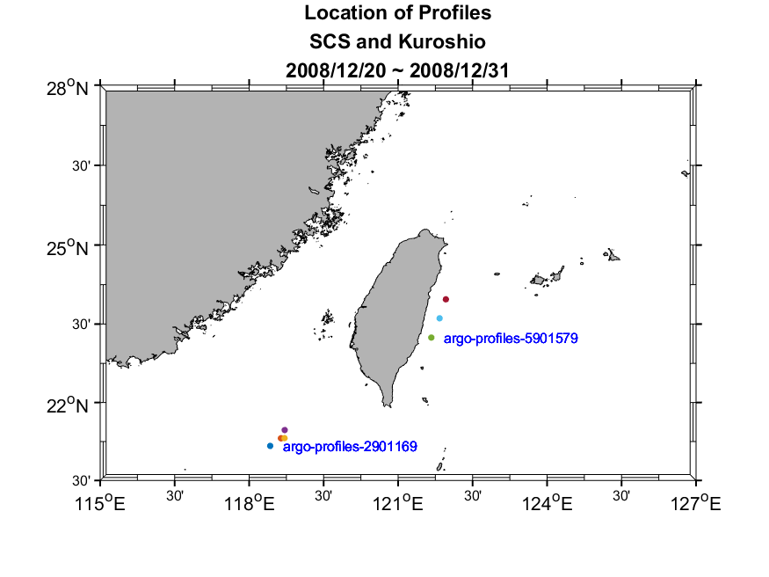
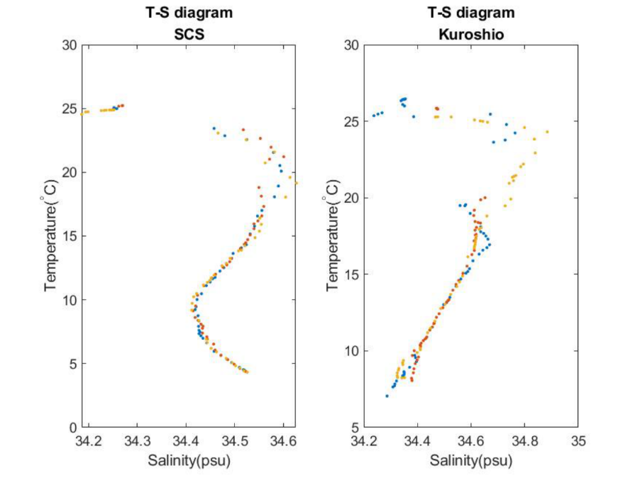
Group 1

Slide 3
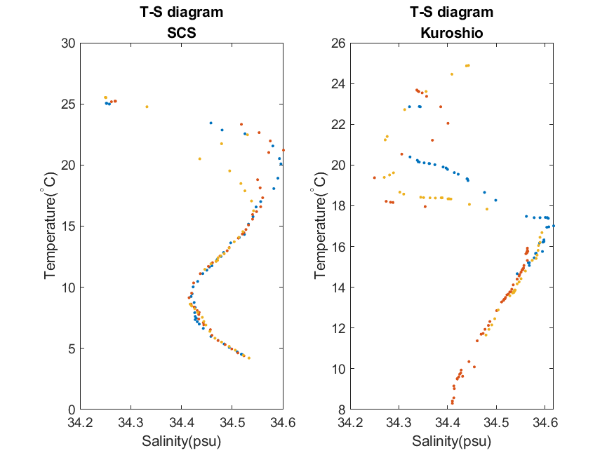
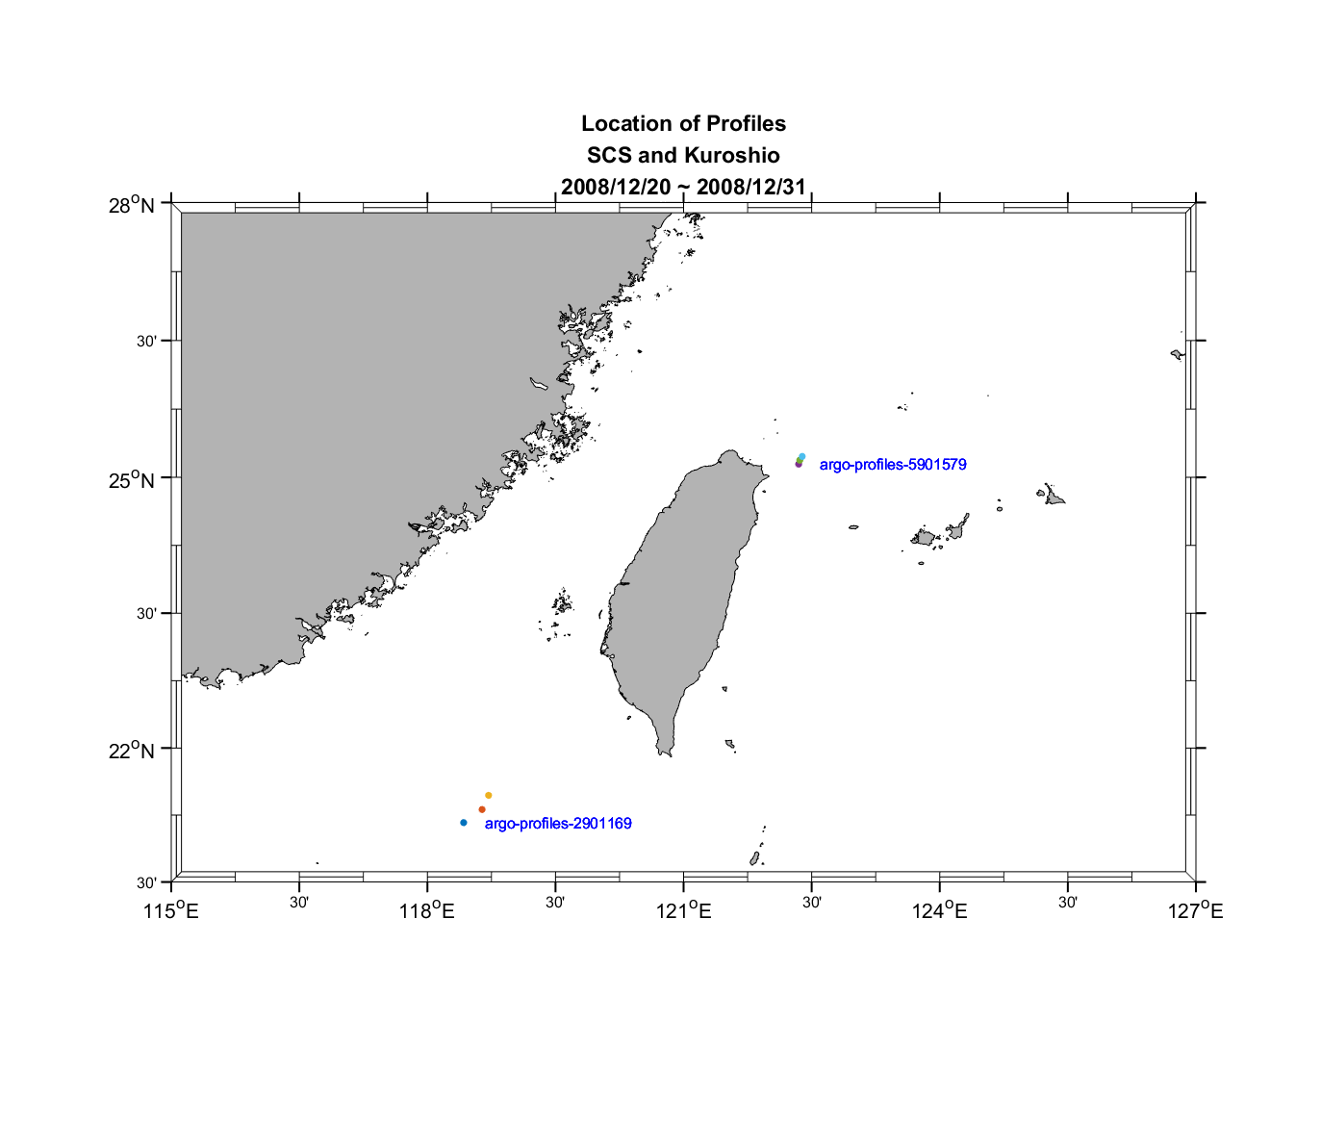
Group 1

Slide 4
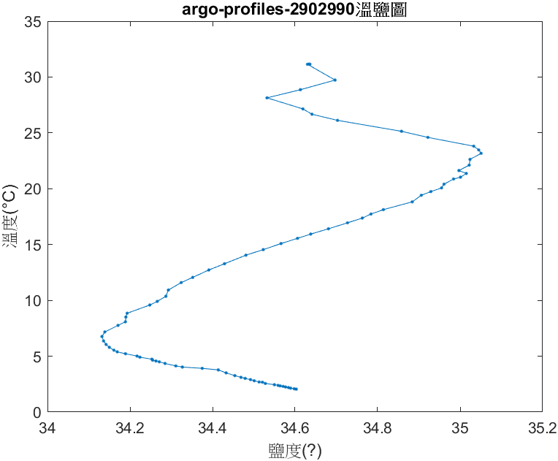
Group 2

Slide 5
Group 2
鹽度最高
海域 | 黑潮 | 南海
溫度 | 20-25℃ | 15-25℃
鹽度最低
海域 | 黑潮 | 南海
溫度 | 5-10℃ | 25-30℃
平均鹽度/水溫
海域 | 黑潮 | 南海
平均鹽度 | 34.5‰ | 34.2963‰
平均水溫(垂直) | 12.8℃ | 18.7518℃

Slide 6
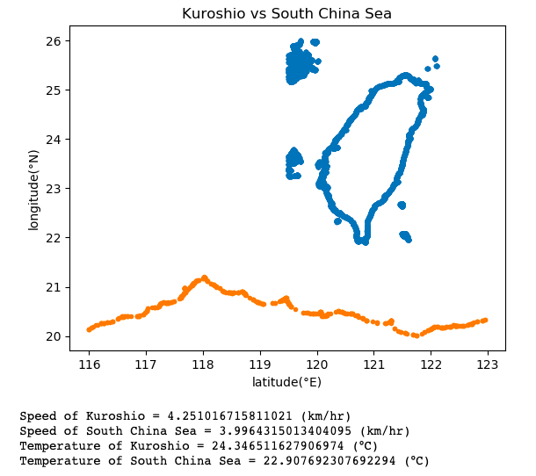
Group 3
日期：2015/01/01~2015/01/30
資料範圍：116~123°E / 18~22°N
以121~122°E範圍的資料作為黑潮的資料範本；
以116~117°E範圍的資料作為南海的資料範本。
比較兩者之間的平均流速
黑潮流速約4.25(km/hr) > 南海流速約3.99(km/hr)
比較兩者之間的平均溫度
黑潮溫度約 24.34(°C) > 南海流速約22.90(°C)
Discussion?

Slide 7
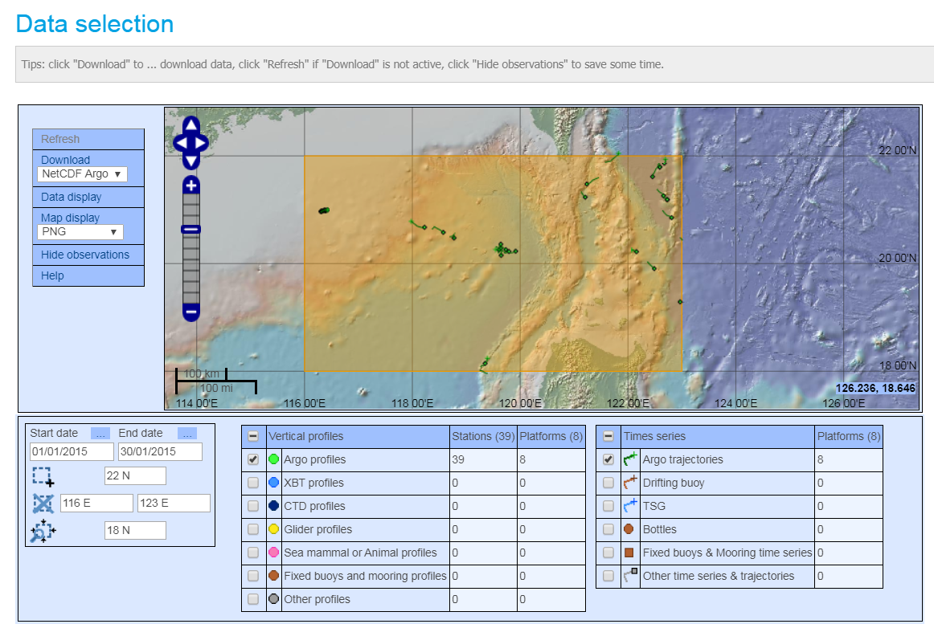
Result cannot be reproduced?

Slide 8
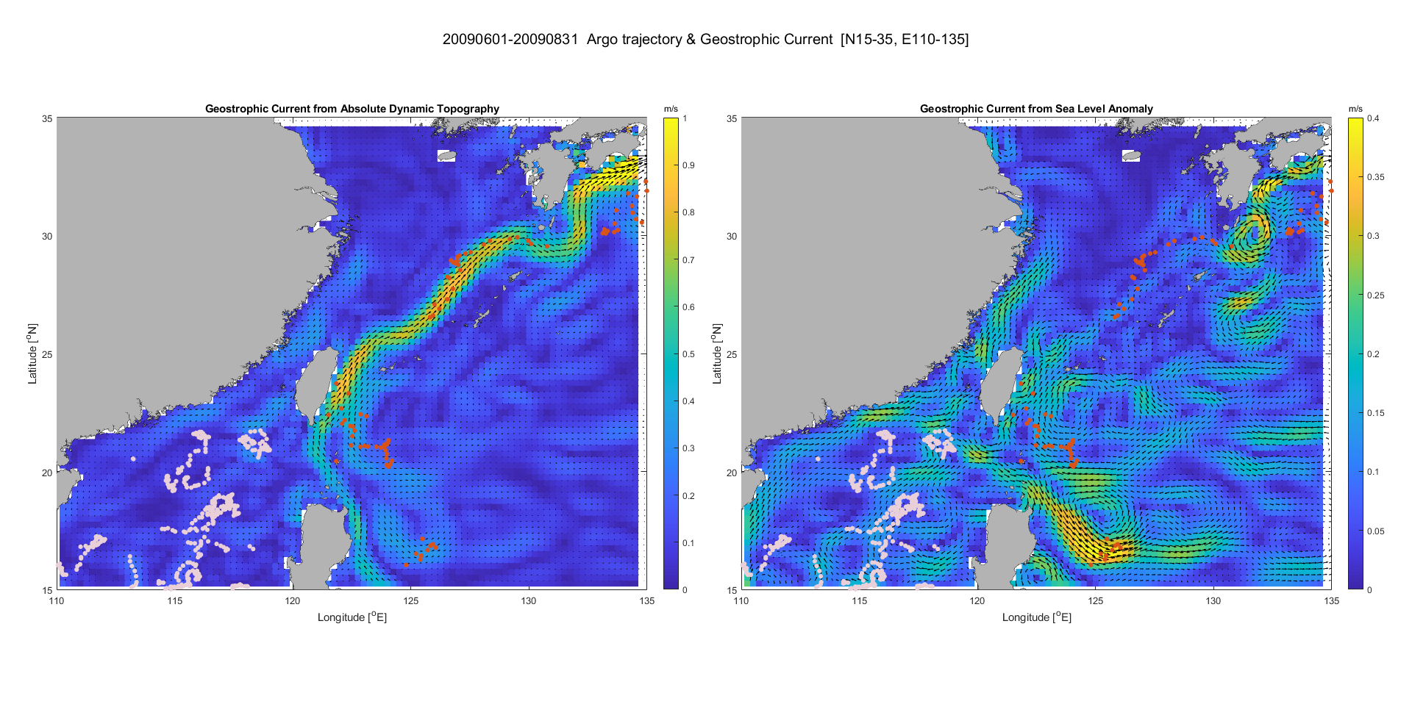
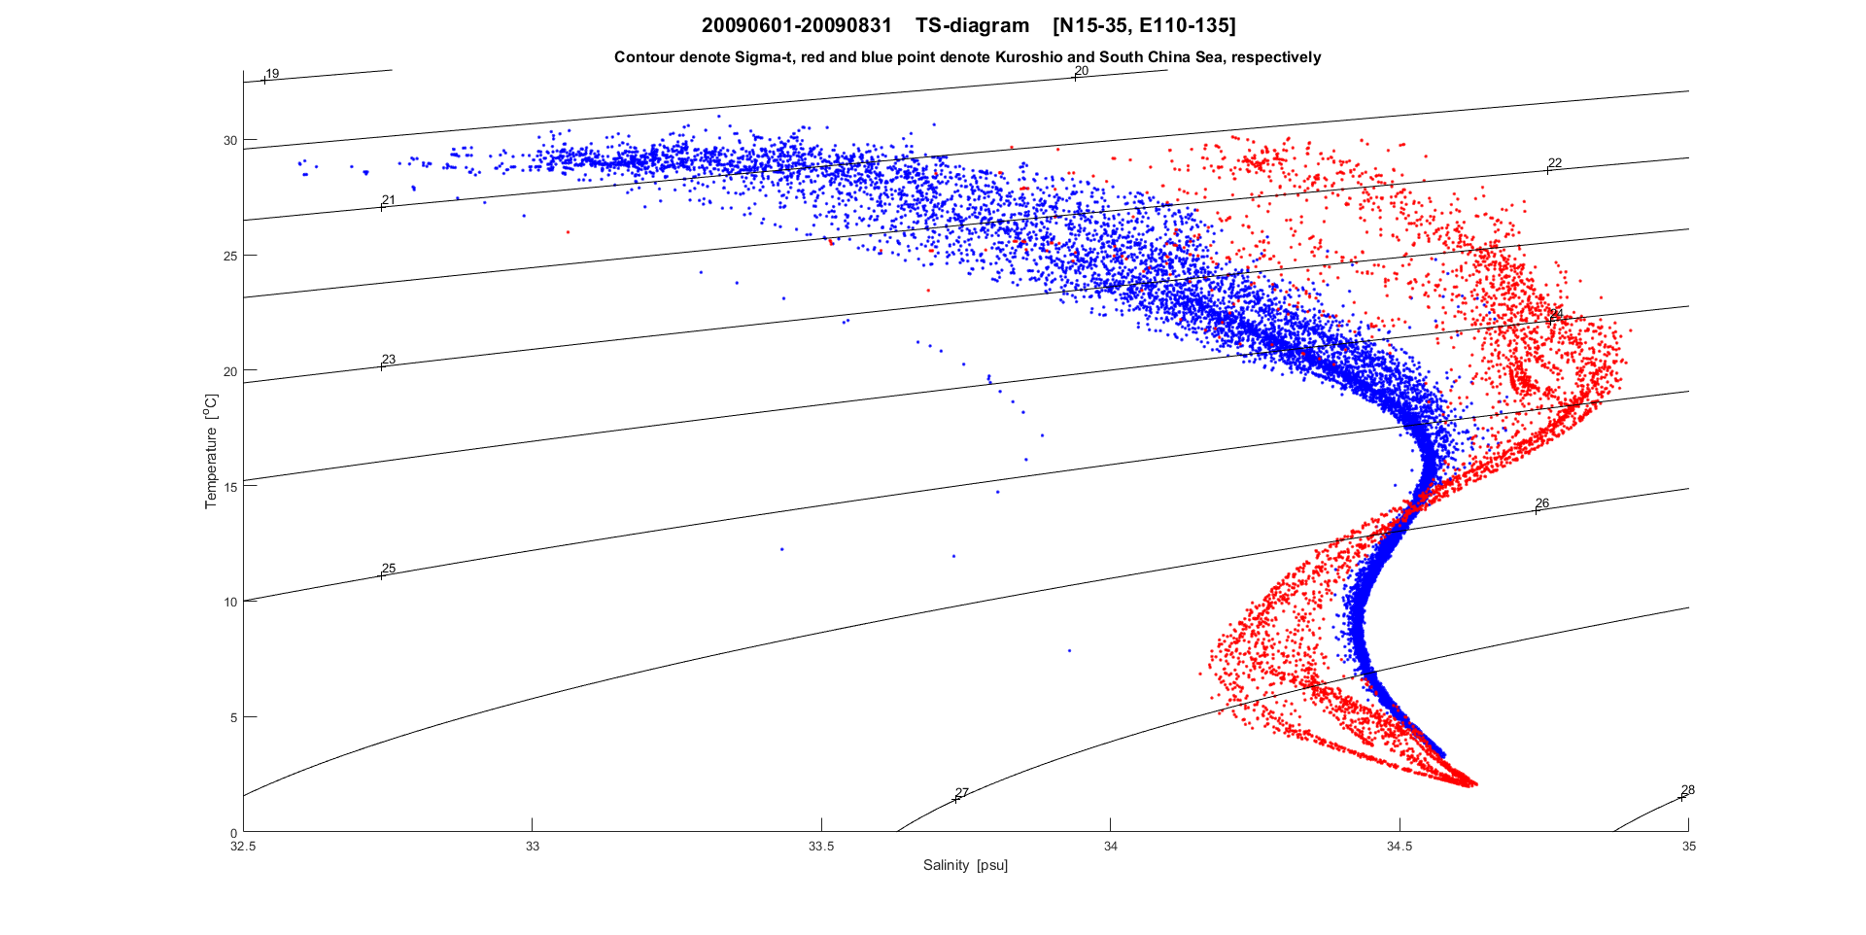
Group 4 (summer)

Slide 9
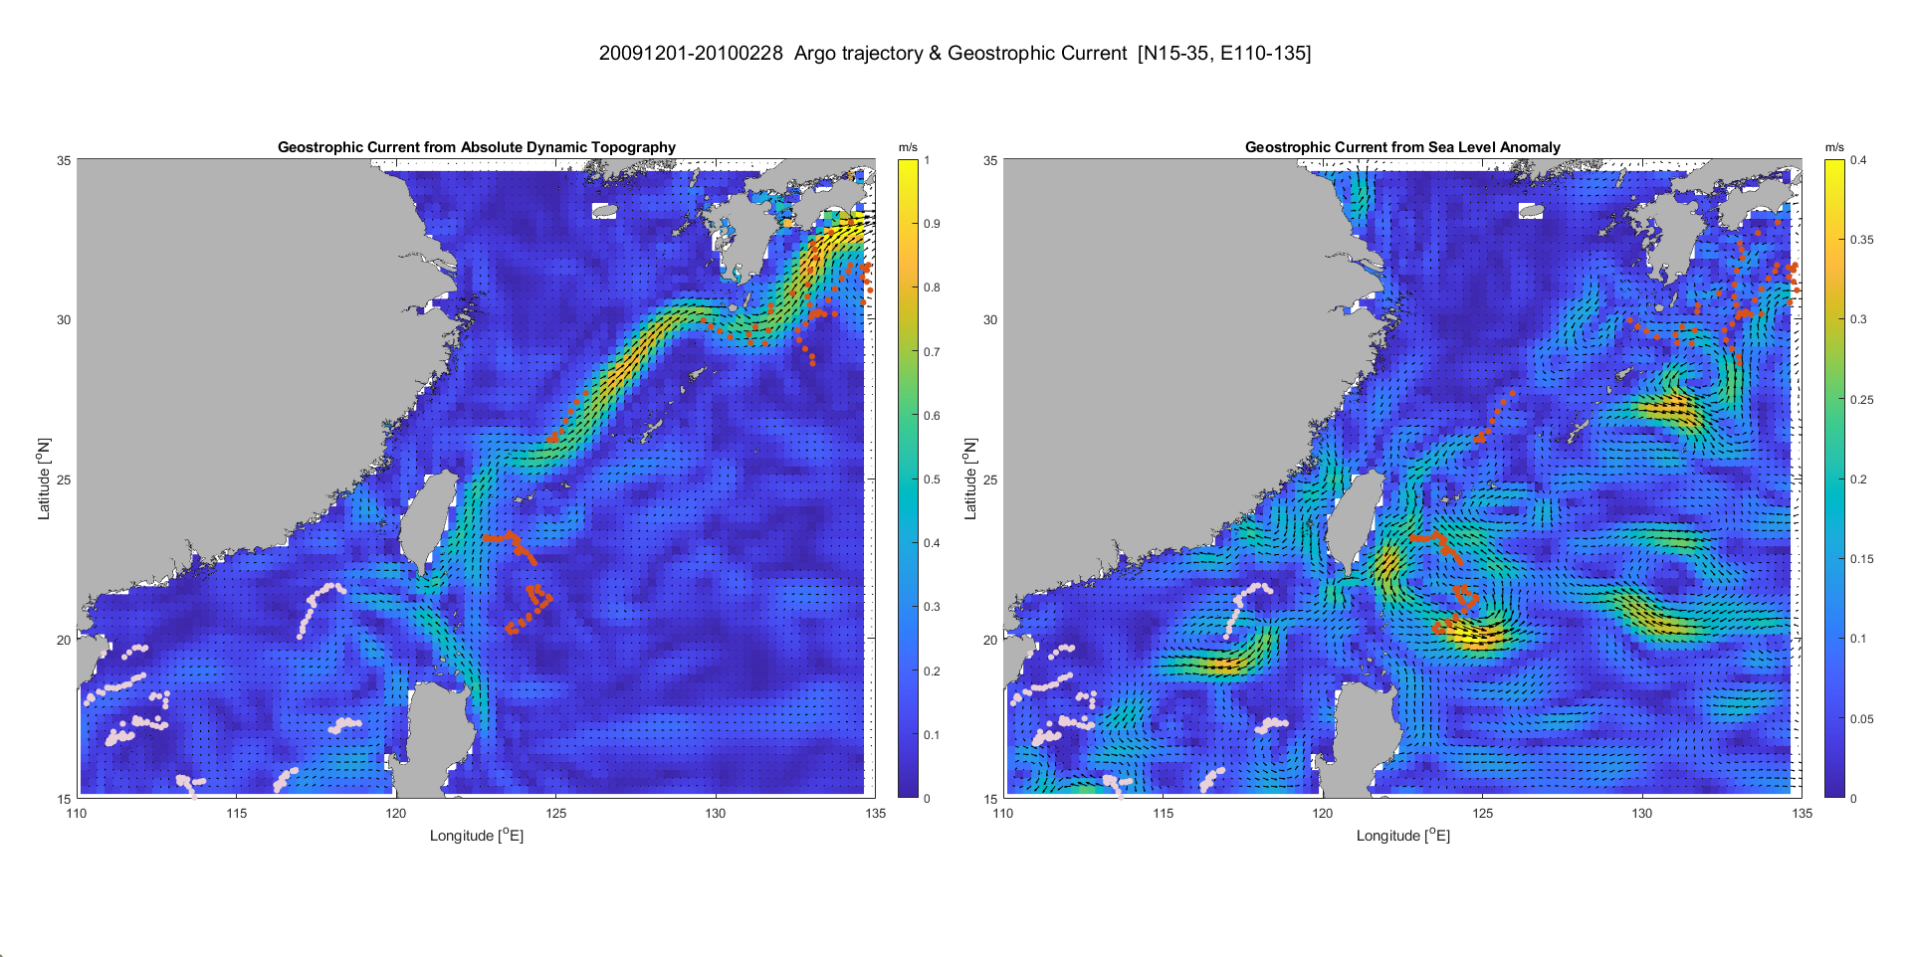
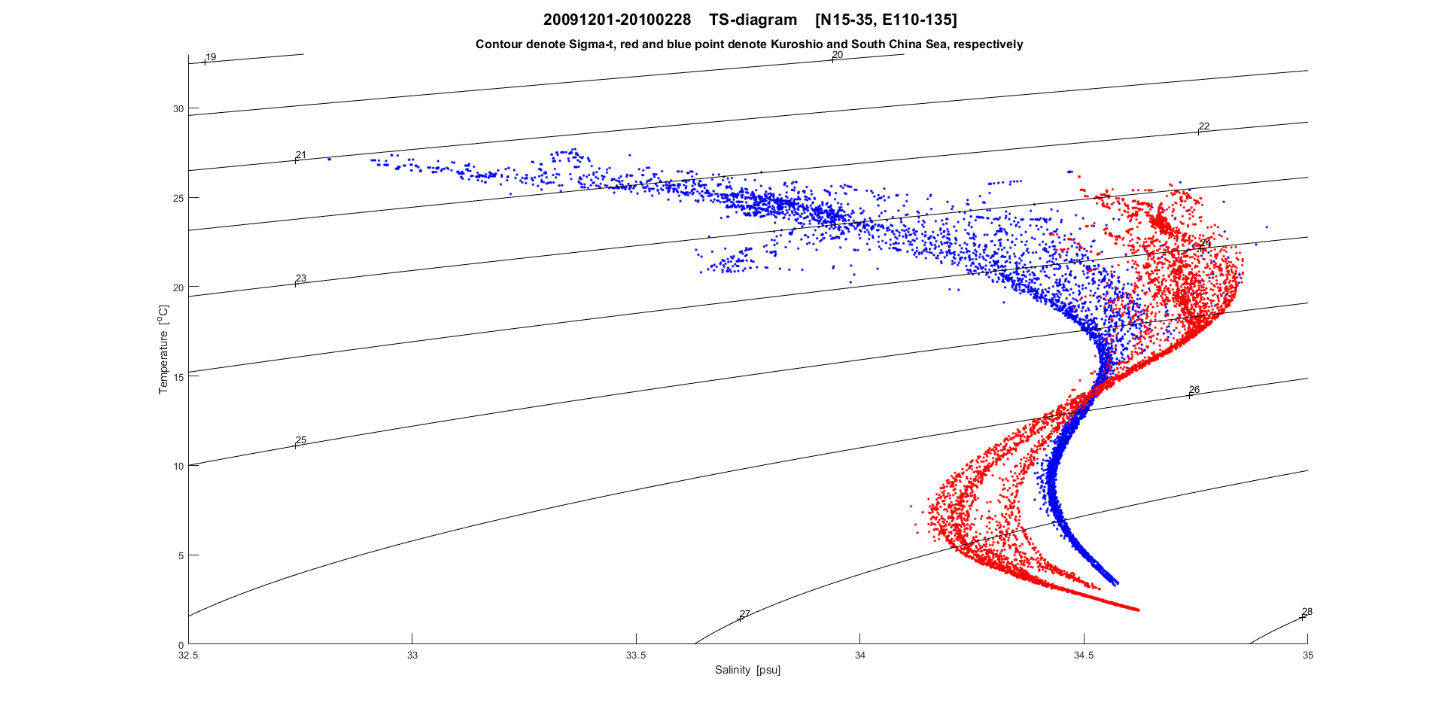
Group 4 (winter)

Slide 10
Sea-going experiment

Slide 11
Final Report using “cr2370.zip” (Due date: 6/19)
(25%) What are the main direction of the observed currents around the Keelung Island during the cruise experiment of CR2370 (using “cr2370000_000000.LTA”)?
(25%) Describe the ocean currents during the cruise experiment.
(25%) Guess: what is the main force that drives the observed currents around the Keelung Island?
(25%) Describe the ocean vertical structure during the cruise experiment (using “c*-1.txt”). Could we find the thermocline?

Slide 12
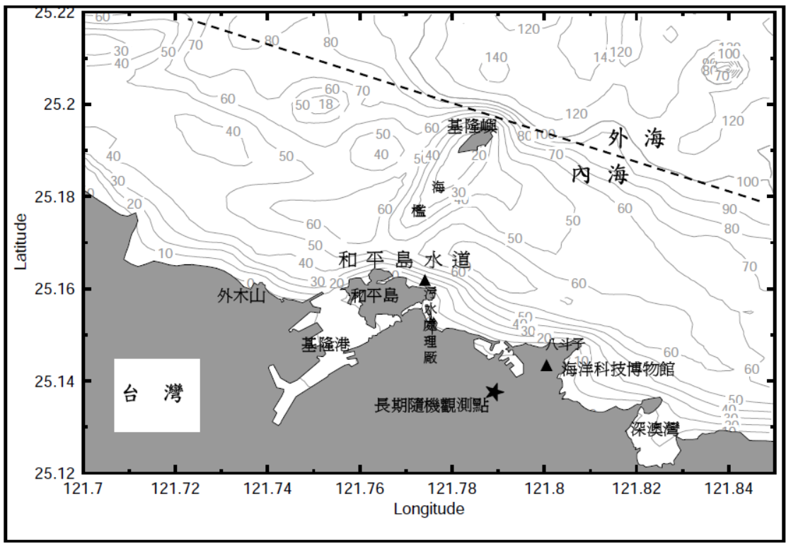
T1
*
C4
*
C3
T2
*
C2
*
C1

Slide 13
Some background
What are the type of currents near coastal region?
What are tides?
Tides are “forced Gravity waves” caused by the gravitational attraction of the moon and sun.
What are tidal currents?
Ocean currents that are generated by tides.

Slide 14
Importance of tidal currents
Navigation
Mixing coastal waters.
Generate internal waves over seamounts, the continental slope, and mid-ocean ridges. This contributes to mixing in the ocean.
Suspend bottom sediments, even in the deep ocean

Slide 15
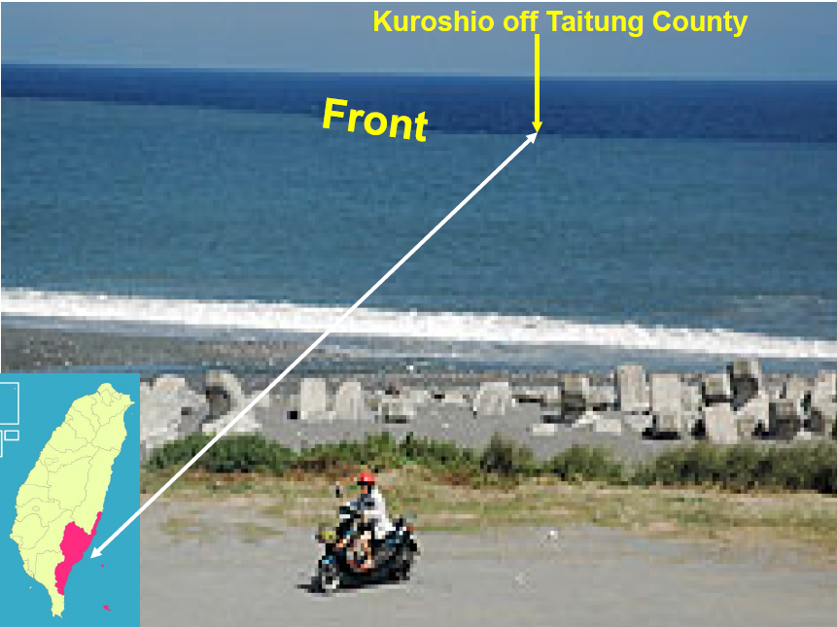
Without Well Mixing
TU05 - Igor Belkin

Slide 16
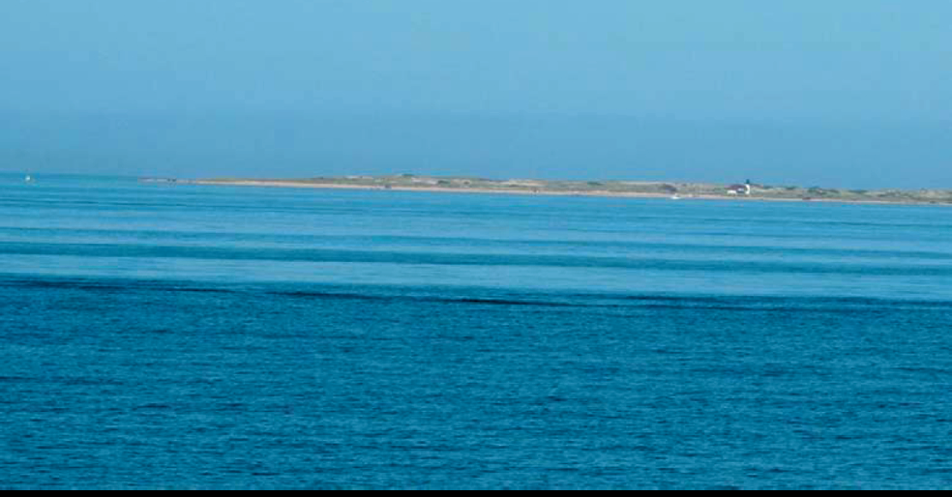
Without Well Mixing
Notes:
Figure 12.1. Slick bands associated with internal waves off Cape Cod (Massachusetts, U.S.A.).
In the background, Cape Cod and Herring Cove beach can be seen, as well as Race Point
lighthouse. Slicks such as these can be seen in satellite images, such as SARimages, revealing the
full spatial structure and scales of short-period internal waves (photo taken by the co-author on
August 30, 2006, at 15:30 local time).

Slide 17
基隆附近海域地理和海檻結構
N
基隆嶼
外海
海
檻
內海
和 平 島 水 道
和平島
污水處理場
基隆港
八斗子
海洋科技博物館
台 灣
長期隨機觀測地點

Slide 18
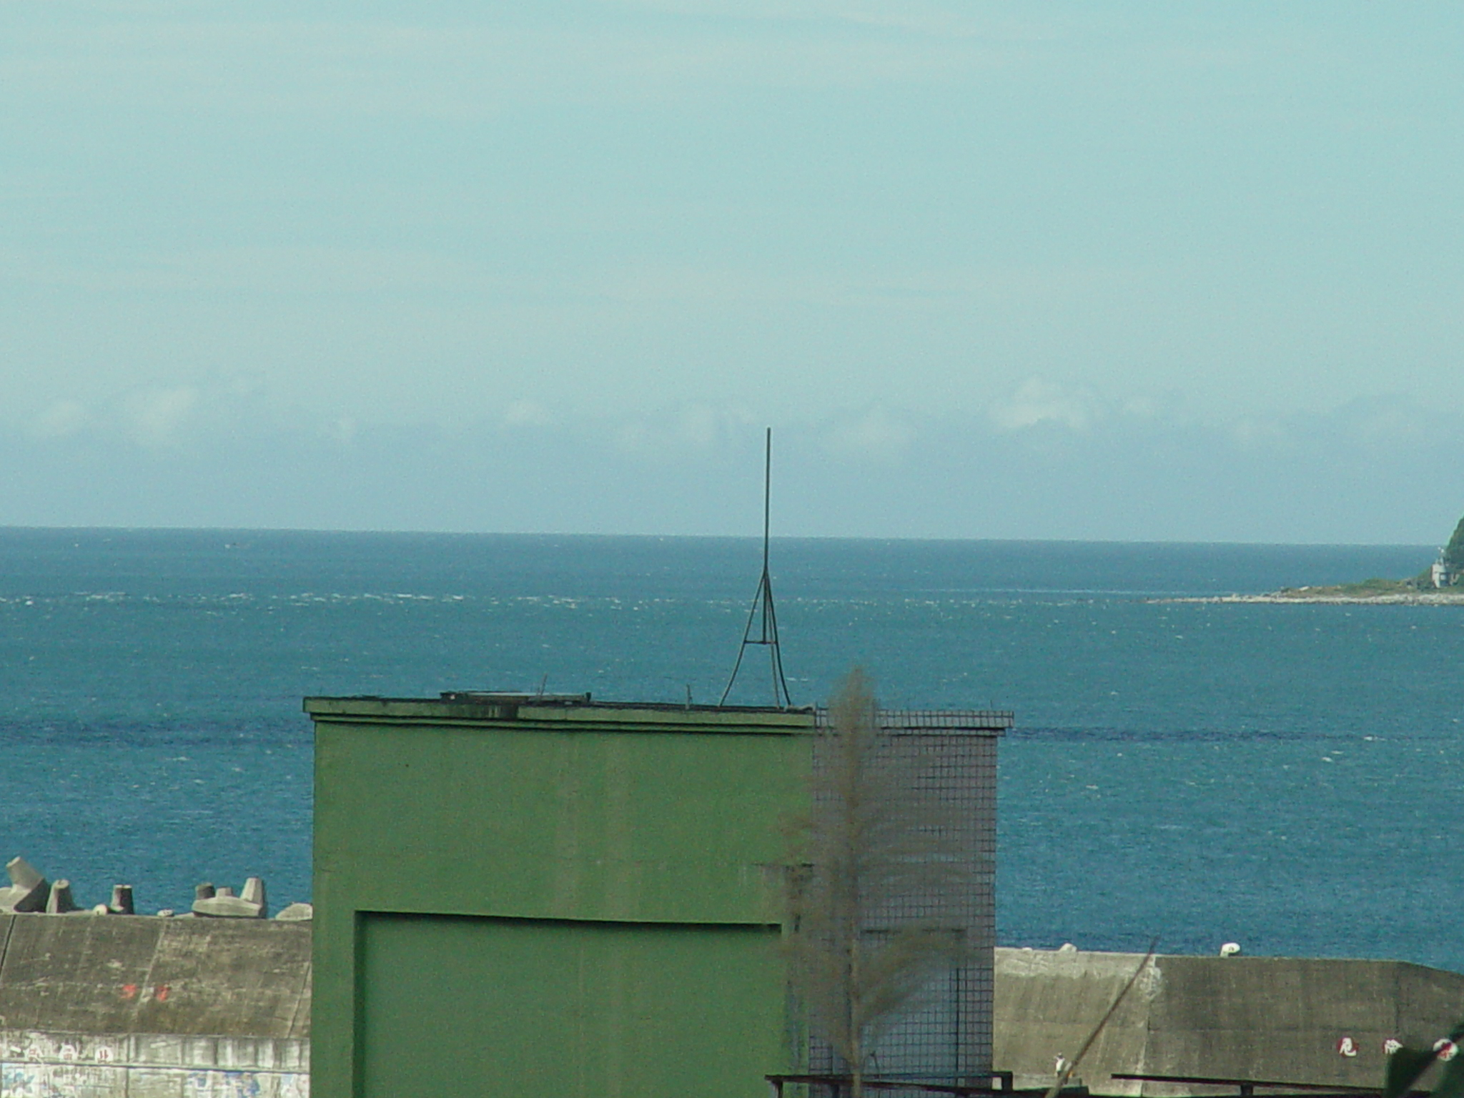

Slide 19
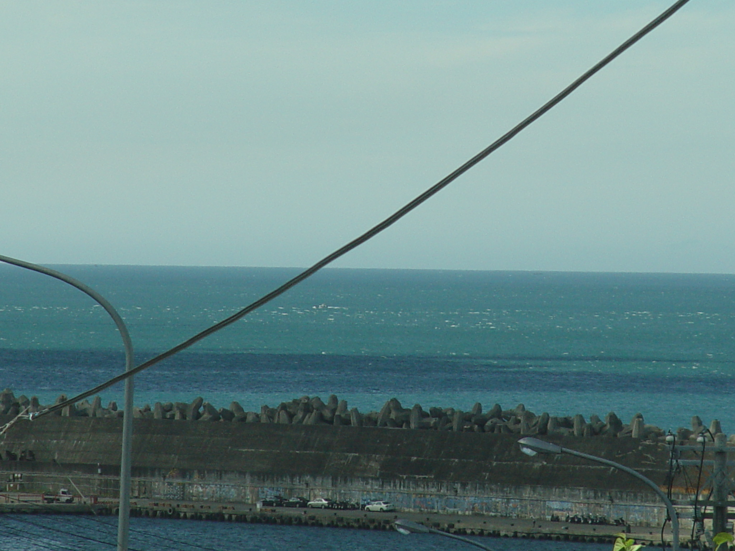

Slide 20
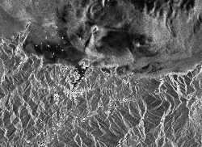

Slide 21
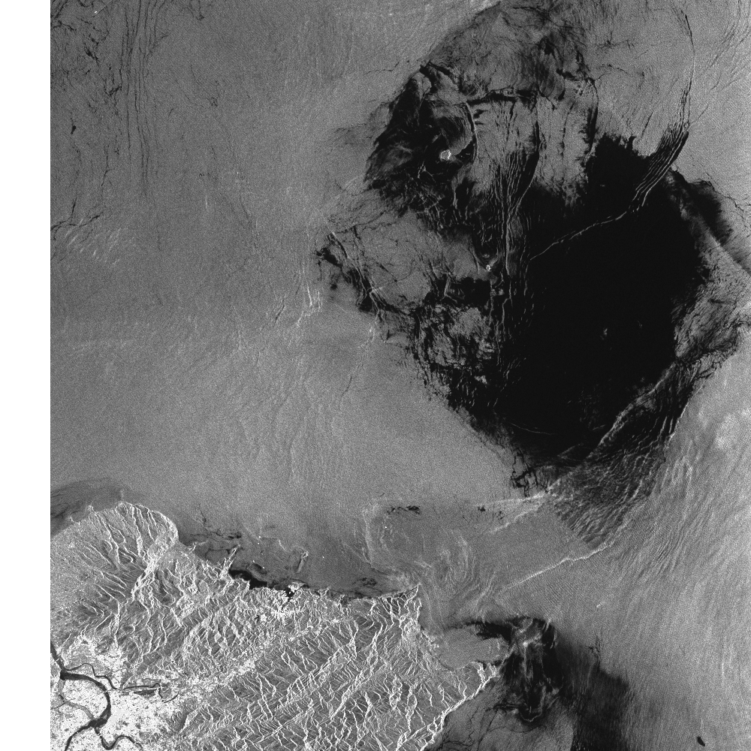

Slide 22
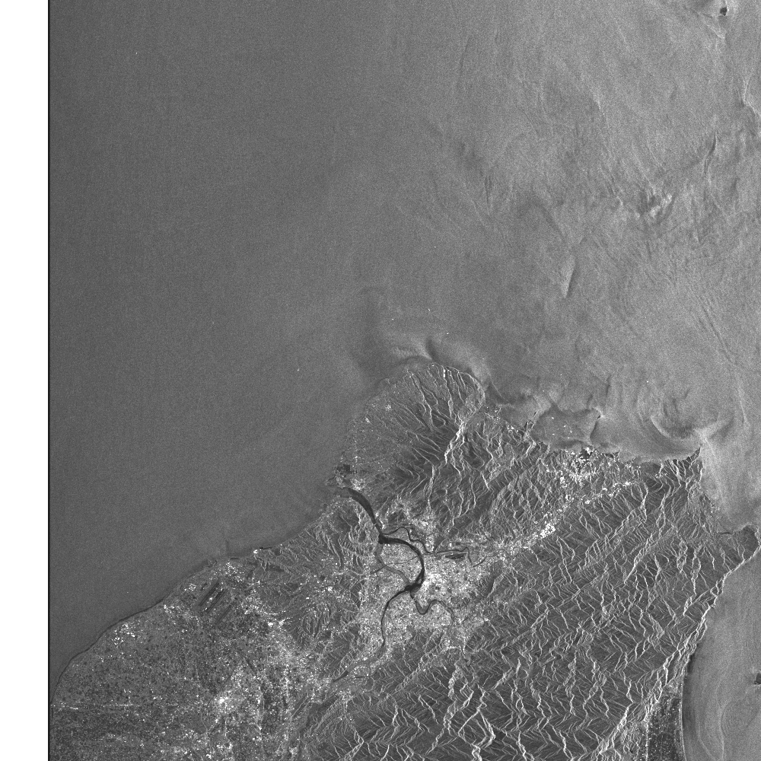
Interesting tide-driven feature near NTOU

Slide 23
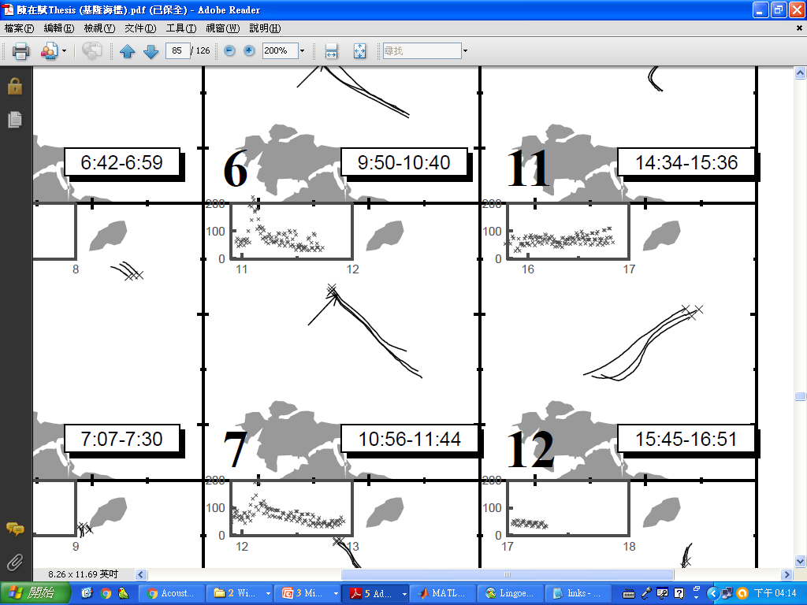
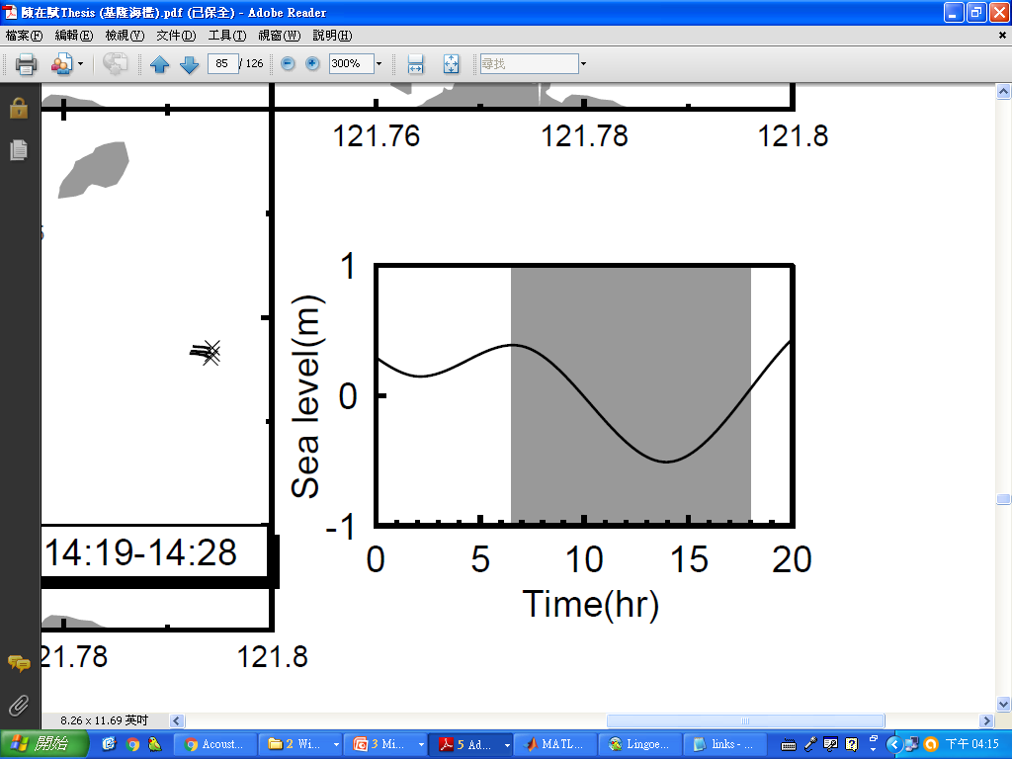
Tidal currents
Consider the Coriolis Force or not to the tidal currents?

Slide 24
About the experiments
T1
*
C4
*
C3
T2
*
C2
*
C1

Slide 25
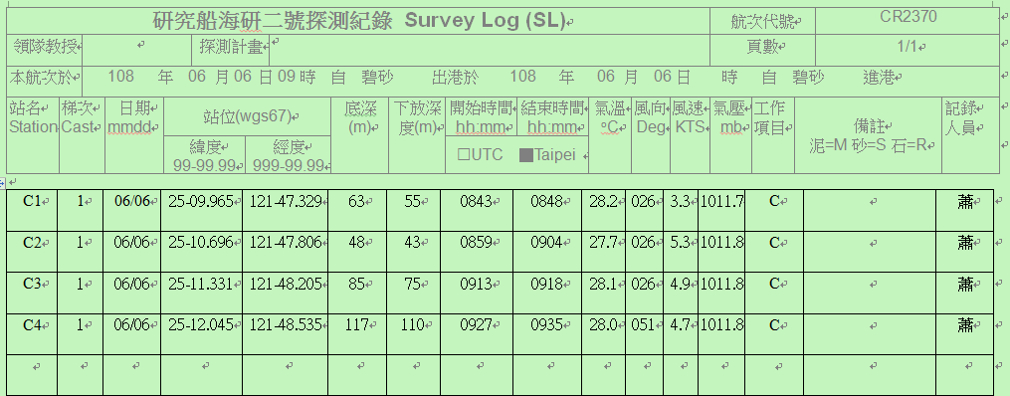
About the experiments

Slide 26
Data
c1-1.txt
c2-1.txt
c3-1.txt
c4-1.txt
cr2370000_000000.LTA

Slide 27
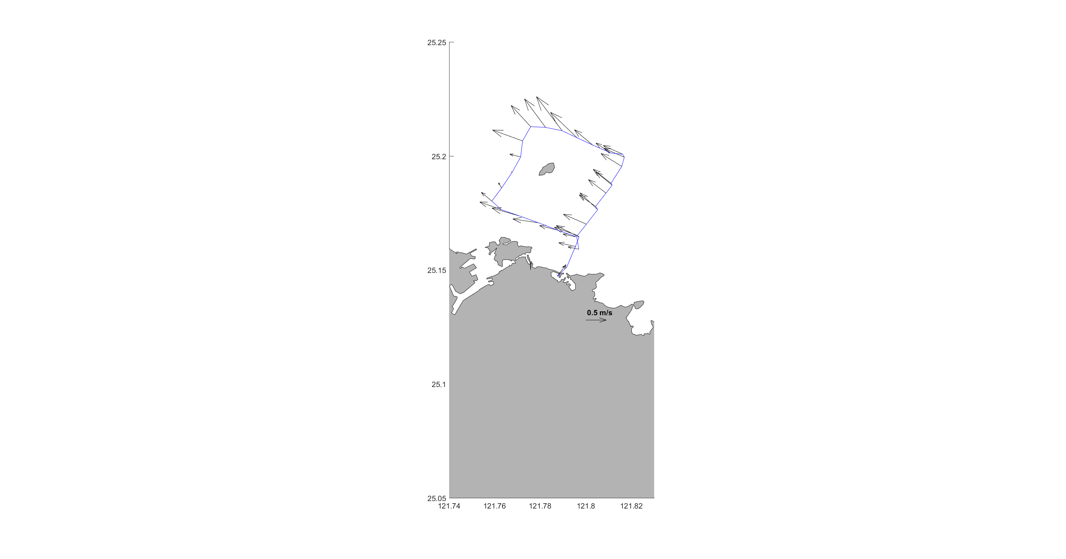

ADCP data analysis (removing bottom track)
0~50m
0~16m
Describe the ocean currents during the cruise experiment.

Slide 28
Checking tides (demo 10 mins)
https://www.cwb.gov.tw/V8/C/M/tide.html
https://www.worldtides.info/
https://www.tide-forecast.com/
Guess: what is the main force that drives the observed currents around the Keelung Island?

Slide 29
CTD Analysis
Describe the ocean vertical structure during the cruise experiment

Slide 30
CTD Analysis
Describe the ocean vertical structure during the cruise experiment

Slide 31
About the experiments
T1
*
C4
*
C3
T2
*
C2
*
C1

Slide 32
CTD Analysis (C1)
Could we find the thermocline?

Slide 33
CTD Analysis (C2)
Could we find the thermocline?

Slide 34
CTD Analysis (C3)
Could we find the thermocline?

Slide 35
CTD Analysis (C4)
Could we find the thermocline?

Slide 36
About the experiments
T1
*
C4
*
C3
T2
*
C2
*
C1

Slide 37
Useful sources/links

Slide 38
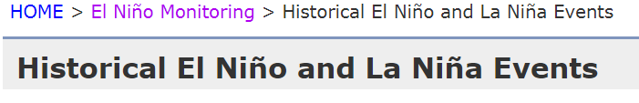
Sources for ENSO (El Niño-Southern Oscillation) Index, JMA
http://ds.data.jma.go.jp/tcc/tcc/products/elnino/ensoevents.html

Slide 39
Review Wind data (JMA)
Japan Meteorological Agency (JMA) – Reanalysis data
http://ds.data.jma.go.jp/tcc/tcc/products/clisys/index.html
Asian monsoon monitoring → Animation maps (Global Area)
SLP & 2-m temperature & 10-m Wind Vector (10-m winds are about surface winds)

Slide 40
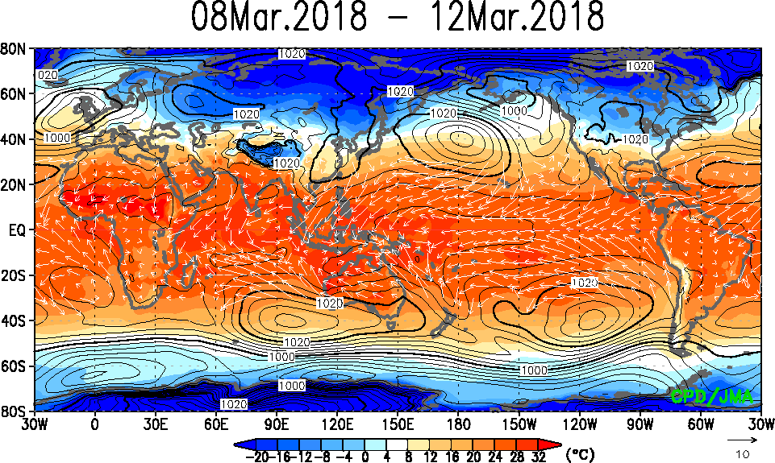
Review Wind data (JMA)

Slide 41
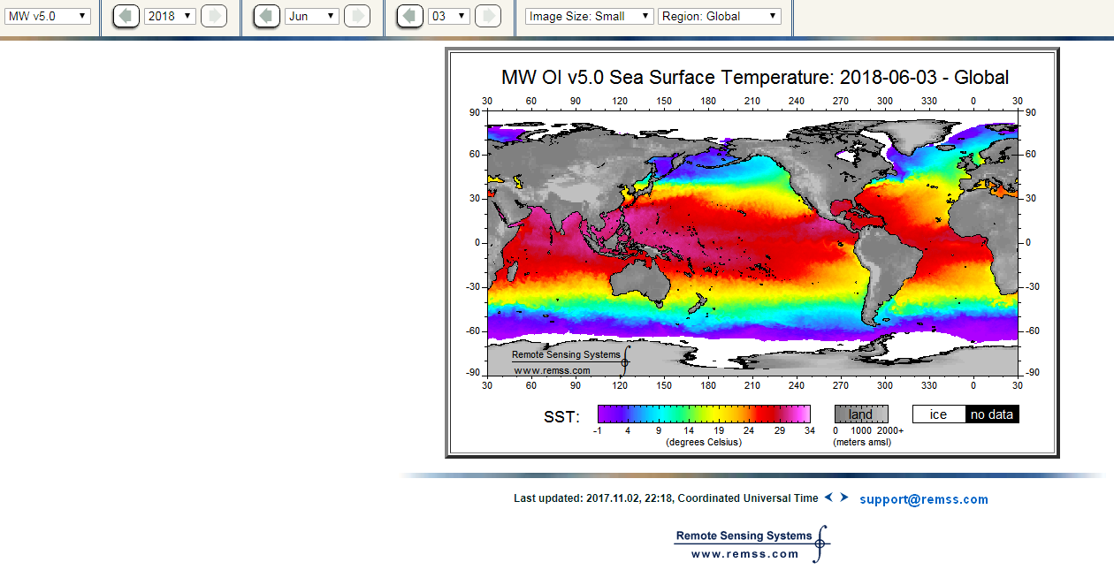
Satellite SST (Demo 5~10 mins)
http://images.remss.com/sst/sst_data_daily.html

Slide 42
Review Satellite Wind data (RSS)
Remote Sensing Systems (RSS) – Satellite observation
http://www.remss.com/
Missions → WindSat → Browse Wind vector images

Slide 43
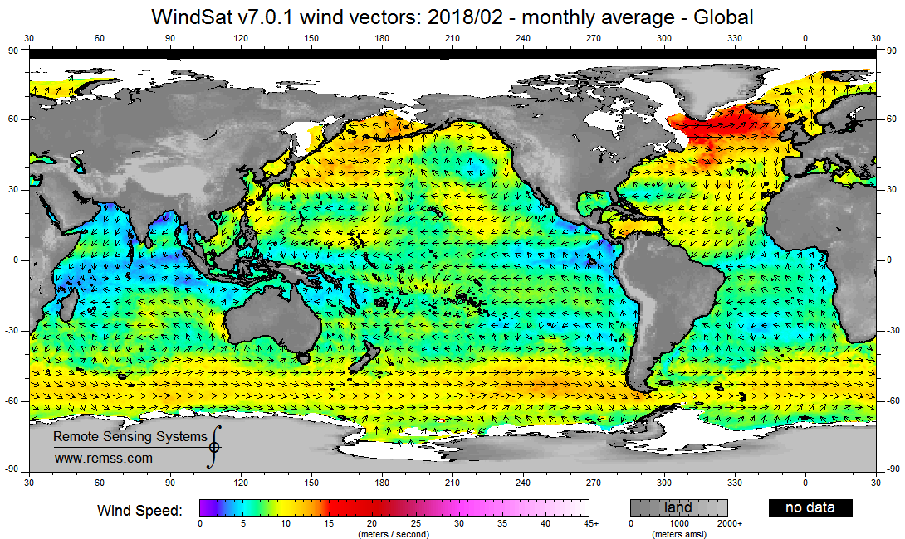
Review Satellite Wind data (RSS)

Slide 44
Review Satellite Rainfall (RSS)
Remote Sensing Systems (RSS) – Satellite observation
http://www.remss.com/measurements/rain-rate/
Browse WindSat

Slide 45
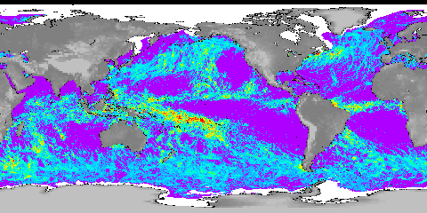
Review Satellite Rainfall (RSS)

Slide 46
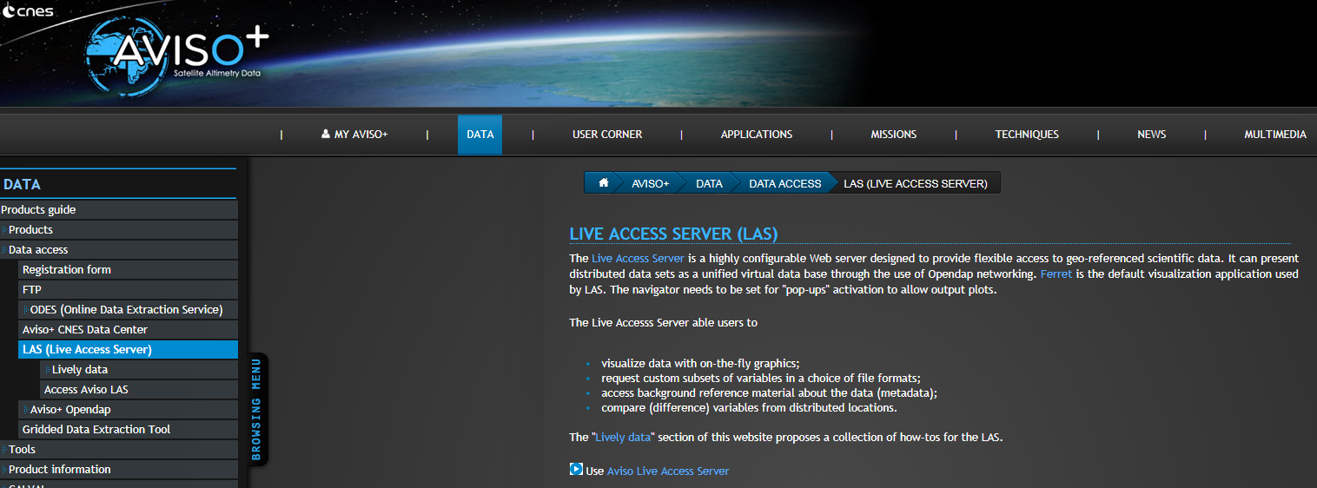
Review Satellite altimeter data from AVISO
Google Keywords: AVISO LIVE ACCESS SERVER

Slide 47
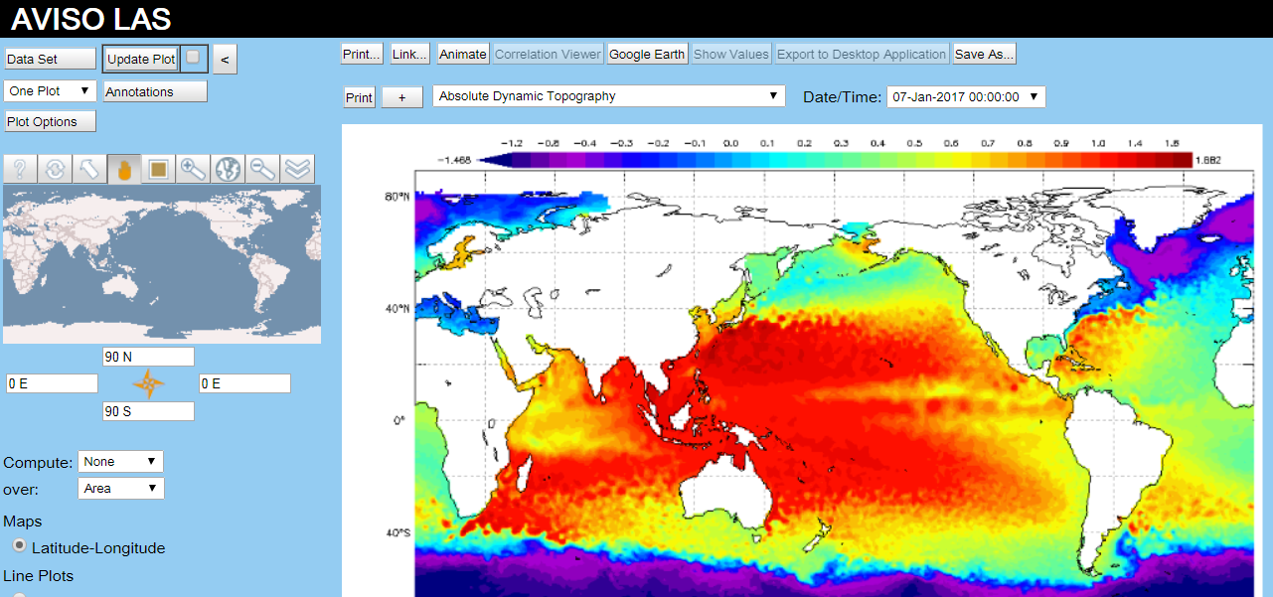
Review Satellite altimeter data from AVISO

Slide 48
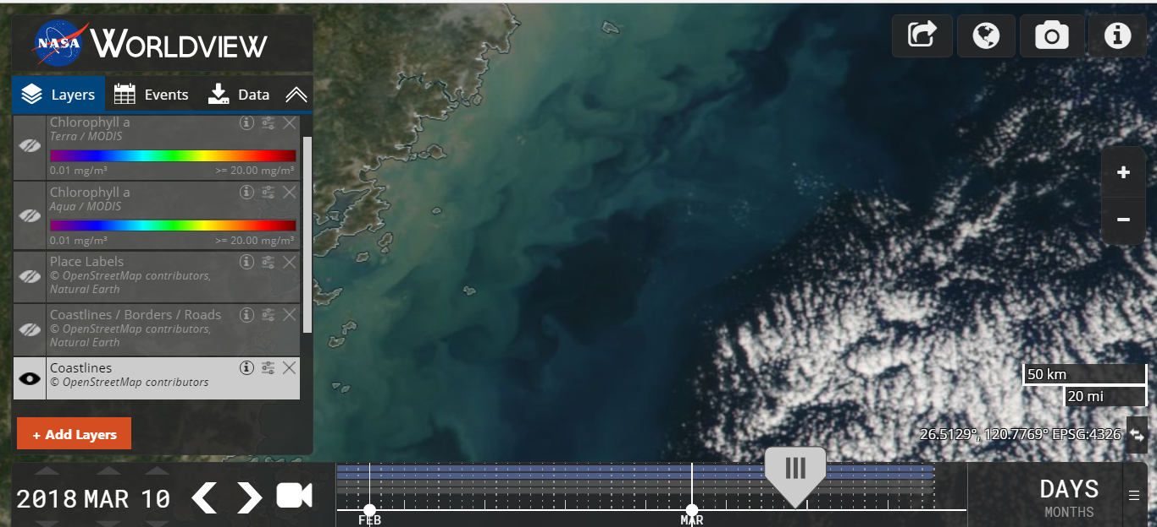
NASA worldview (Ocean color, True color)
https://worldview.earthdata.nasa.gov/
Demo 10~15 mins

Slide 49
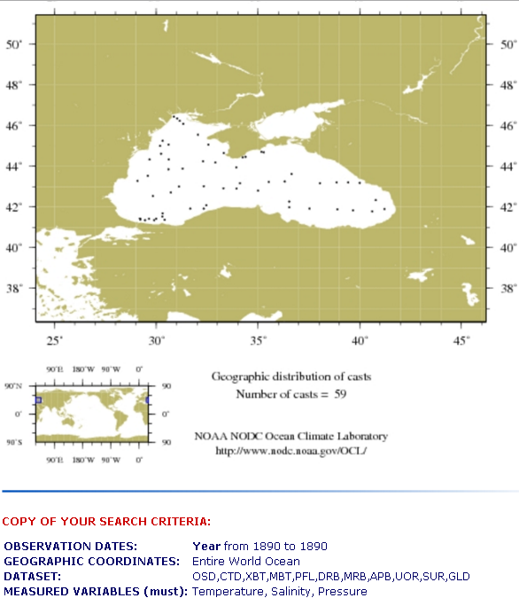
An useful link
https://www.nodc.noaa.gov/OC5/indprod.html

Slide 50
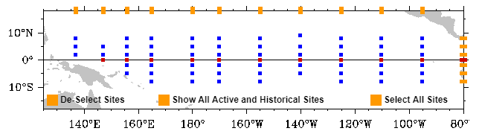
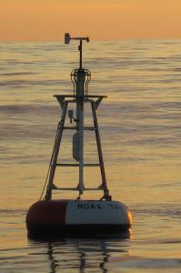
Mooring stations (Tropical regions) (with depth, fixed locations)
Keywords: Global Tropical Moored Buoy Array, TAO array

Slide 51
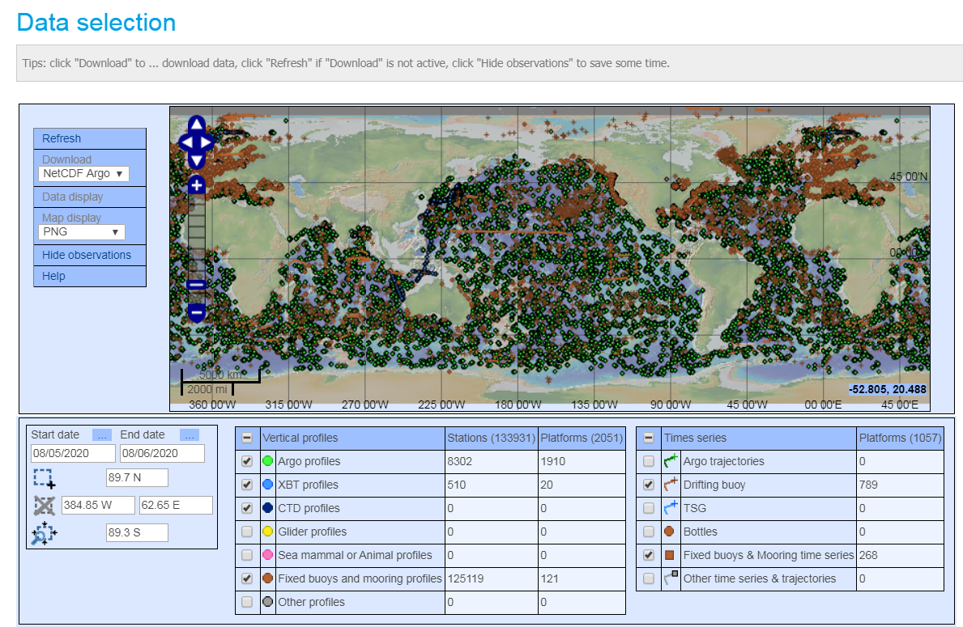
All in-situ observation (coriolis)
http://www.coriolis.eu.org/Data-Products/Data-Delivery/Data-selection

Slide 52
教學進度 Schedule
Introduction: Why do we need to observe ocean currents?
Some basic tools for programming and scientific plotting: Matlab, Python, Julia Language, GMT, Ocean Data View (additional topics for students) & some required mathematics (下周)
Methods of observing currents: In-situ and satellite observations (1~2週)
Data and links of observations for ocean currents (1~2週)
Drifter data analysis

Slide 53
教學進度 Schedule
ADCP data analysis
Shipboard ADCP calibration (data processing for bottom-track ship velocities)
Shipboard ADCP calibration (data processing for GPS ship velocities)
Current Meters
Hydrographic (CTD, XBT, ARGO) data analysis
Wind-driven Circulation

Slide 54
評量方式 Grading
1.作業(Homework)：30% 2.課堂討論和發問(Discussion): 30% (0.3%/time) 3.個人報告(Reports)：20%
4.分組討論及報告:20%

Slide 55
Final Report using “cr2370.zip” (Due date: 6/19)
(25%) What are the main direction of the observed currents around the Keelung Island during the cruise experiment of CR2370 (using “cr2370000_000000.LTA”)?
(25%) Describe the ocean currents during the cruise experiment.
(25%) Guess: what is the main force that drives the observed currents around the Keelung Island?
(25%) Describe the ocean vertical structure during the cruise experiment (using “c*-1.txt”). Could we find the thermocline?

